Slide 1
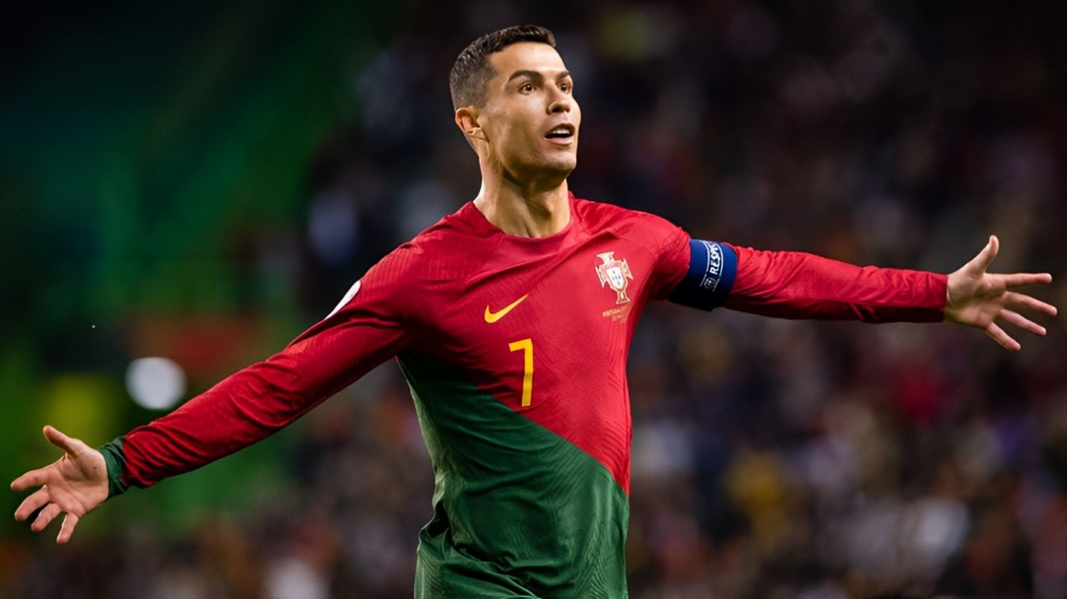
RONALDO
RONALDO IS THE WORLD'S MOST FAMOUS FOOTBALLER . HE PLAYS FOR THE PORTUGAL'S NATIONAL FOOTBALL TEAM HIS SHIRT'S NUMBER IS 7 . HE HAS A YOUTUBE CHANNEL NAMED UR CHRISTIANO.
THROPHIES​
​
​
RONALDO HAVE 5 FIFA BALLON d'Or IN 2008,2016,2018 WITH ADDITIONAL WINS IN 2007 AND 2018 , 4 FIFA CLUB WORLDCUP IN 2008,2014,2016 AND 2017 ETC​
​
RONALDO
RONALDO IS COMEPETER
RONALDO'S BEST COMPETER IS LIOEL MESSI HE IS ALSO A GOOD PLAYER HIS SHIRTS NUMBER IS 10 HE PLAYS FOR ARGENTINA'S NATIONAL FOOTBALL TEAM HE HAS A YOUTUBE CHANNEL NAMED LEO MESSI.
WORLD'S MOST FAMOUS FOOTBALLER . HE PLAYS FOR THE PORTUGAL'S NATIONAL FOOTBALL TEAM HIS SHIRT'S NUMBER IS 7 . HE HAS A YOUTUBE CHANNEL NAMED UR CHRISTIANO.
RONALDO

Slide 2
RONALDO​
​
RONALDO IS THE WORLD'S COMEPETER
RONALDO'S BEST COMPETER IS LIOEL MESSI HE IS ALSO A GOOD PLAYER HIS SHIRTS NUMBER IS 10 HE PLAYS FOR ARGENTINA'S NATIONAL FOOTBALL TEAM HE HAS A YOUTUBE CHANNEL NAMED LEO MESSI.
FAMOUS FOOTBALLER . HE PLAYS FOR THE PORTUGAL'S NATIONAL FOOTBALL TEAM HIS SHIRT'S NUMBER IS 7 . HE HAS A YOUTUBE CHANNEL NAMED UR CHRISTIANO. ​
​
RONALDO​
​
RONALDO IS THE WORLD'S MOST FAMOUS FOOTBALLER . HE PLAYS FOR THE PORTUGAL'S NATIONAL FOOTBALL TEAM HIS SHIRT'S NUMBER IS 7 . HE HAS A YOUTUBE CHANNEL NAMED UR CHRISTIANO. ​
​
THROPHIES​
​
​
RONALDO HAVE 5 FIFA BALLON d'Or IN 2008,2016,2018 WITH ADDITIONAL WINS IN 2007 AND 2018 , 4 FIFA CLUB WORLDCUP IN 2008,2014,2016 AND 2017 ETC​
​
RONALDO

Slide 3
RONALDO
RONALDO IS COMEPETER
RONALDO'S BEST COMPETER IS LIOEL MESSI HE IS ALSO A GOOD PLAYER HIS SHIRTS NUMBER IS 10 HE PLAYS FOR ARGENTINA'S NATIONAL FOOTBALL TEAM HE HAS A YOUTUBE CHANNEL NAMED LEO MESSI.
WORLD'S MOST FAMOUS FOOTBALLER . HE PLAYS FOR THE PORTUGAL'S NATIONAL FOOTBALL TEAM HIS SHIRT'S NUMBER IS 7 . HE HAS A YOUTUBE CHANNEL NAMED UR CHRISTIANO.
RONALDO​
​
RONALDO IS THE WORLD'S MOST FAMOUS FOOTBALLER . HE PLAYS FOR THE PORTUGAL'S NATIONAL FOOTBALL TEAM HIS SHIRT'S NUMBER IS 7 . HE HAS A YOUTUBE CHANNEL NAMED UR CHRISTIANO. ​
​
THROPHIES​
​
​
RONALDO HAVE 5 FIFA BALLON d'Or IN 2008,2016,2018 WITH ADDITIONAL WINS IN 2007 AND 2018 , 4 FIFA CLUB WORLDCUP IN 2008,2014,2016 AND 2017 ETC​
​
RONALDO

Slide 4
RONALDO
RONALDO IS THE WORLD'S MOST FAMOUS FOOTBALLER . HE PLAYS FOR THE PORTUGAL'S NATIONAL FOOTBALL TEAM HIS SHIRT'S NUMBER IS 7 . HE HAS A YOUTUBE CHANNEL NAMED UR CHRISTIANO.
THROPHIES
RONALDO HAVE 5 FIFA BALLON d'Or IN 2008,2016,2018 WITH ADDITIONAL WINS IN 2007 AND 2018 , 4 FIFA CLUB WORLDCUP IN 2008,2014,2016 AND 2017 ETC
COMEPETER
RONALDO'S BEST COMPETER IS LIOEL MESSI HE IS ALSO A GOOD PLAYER HIS SHIRTS NUMBER IS 10 HE PLAYS FOR ARGENTINA'S NATIONAL FOOTBALL TEAM HE HAS A YOUTUBE CHANNEL NAMED LEO MESSI.
RONALDO

Slide 5
RONALDO
RONALDO IS THE WORLD'S MOST FAMOUS FOOTBALLER . HE PLAYS FOR THE PORTUGAL'S NATIONAL FOOTBALL TEAM HIS SHIRT'S NUMBER IS 7 . HE HAS A YOUTUBE CHANNEL NAMED UR CHRISTIANO.
THROPHIES
RONALDO HAVE 5 FIFA BALLON d'Or IN 2008,2016,2018 WITH ADDITIONAL WINS IN 2007 AND 2018 , 4 FIFA CLUB WORLDCUP IN 2008,2014,2016 AND 2017 ETC
COMEPETER
RONALDO'S BEST COMPETER IS LIOEL MESSI HE IS ALSO A GOOD PLAYER HIS SHIRTS NUMBER IS 10 HE PLAYS FOR ARGENTINA'S NATIONAL FOOTBALL TEAM HE HAS A YOUTUBE CHANNEL NAMED LEO MESSI.
RONALDO

Slide 6
PRESENTATION MAKER = M.WALEED.ALI
CLASS 5TH
SECTION YELLOW

Slide 7
PRESENTATION MAKER = M.WALEED.ALI
CLASS 5TH
SECTION YELLOW

